Slide 1
Social Internship
For
Smart Gadget for Women Safety
11/12/2021
Prepared by
Specialization | SAP ID | Name
Btech CSE AI and ML | 500076347 | Rajneesh
Btech CSE AI and ML | 500075940 | Rohan Nyati
Btech CSE AI and ML | 500075224 | Shantanu Jaswal
Department of Informatics School Of Computer Science
UNIVERSITY OF PETROLEUM & ENERGY STUDIES,
DEHRADUN- 248007. Uttarakhand

Slide 2
Case Study- Existing systems
ILA security – Alarm shocker
Vithu app- Alert messages to contacts
AESHS – tracks victim location
Society Harassing equipment – causes burns

Slide 3
Drawbacks of existing equipment
Costly
Bulky
No one stop solution
Requires more electronics

Slide 4
OBJECTIVE
Low cost equipment for women to feel safe in this growing world with the help of latest technology
Image capturing of culprit
Location of women under danger

Slide 5
Problem Statement
To build a One stop solution security for women which is portable and also provides self defense to help women escape in critical circumstances.

Slide 6
Requirements
Hardware-
1. Camera , Gps module
2. Battery
3. Ultra Sonic Sensor
Software-
Python programming
ES plorer IDE

Slide 7

Ultrasonic sensors

Slide 8
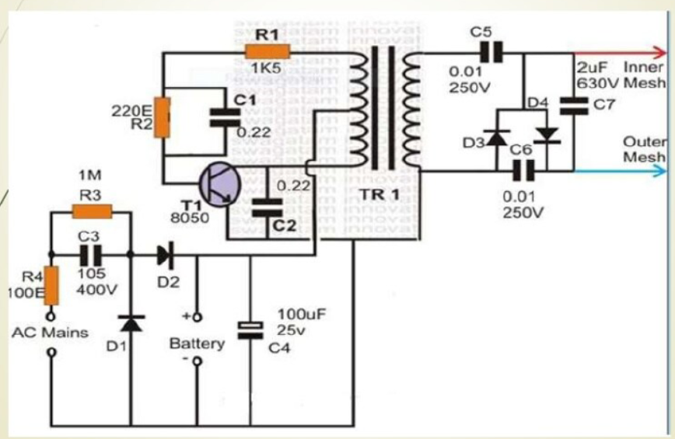
Electric Shock Gloves

Slide 9
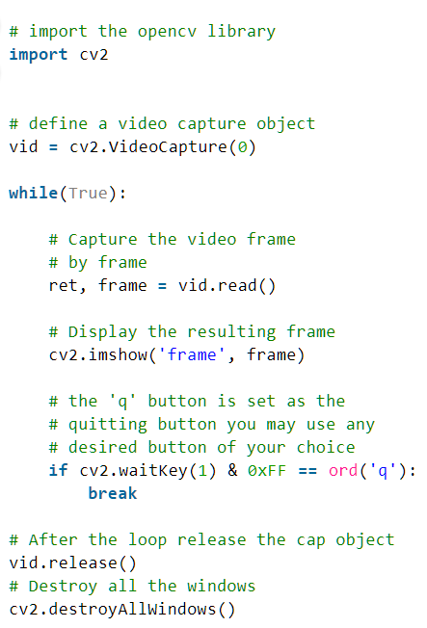
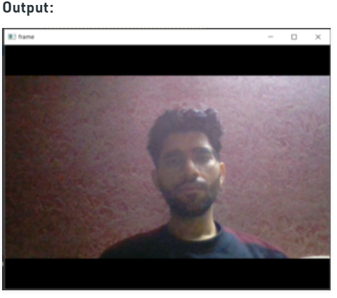
Image capturing with Python

Slide 10

Conclusion
Peace and Prosperity lies in society where women is happy and honoured.

Slide 11
References
Survey on wearable sensor, IEEE Transactions on Systems, Man, and Cybernetics, Part C (Applications and Reviews) ( Volume: 40, Issue: 1, Jan. 2010)
SMART GIRLS SECURITY SYSTEM Prof. Basavaraj Chougula1 , Archana Naik2 , Monika Monu3 , Priya Patil4 and Priyanka Das5 1,2,3,4&5KLE’s College of Engineering and Technology, Belgaum, Dept. of Electronics & Communication
Images from Google.

Slide 12
Thank you

